Slide 1
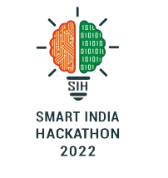

Uncontrolled growth of Water Hyacinth(crassipes) in Lakes
BHARATHIAR UNIVERSITY
Internal Hackathon - SIH 2022
23rd March 2022
Team members
Ms. Lissa M.
Arasu S.S.
Balamurugan K.U.
Govindaraj C.
Raghul D.
Rajagopal S.
Mentor (Academic)
Dr. V. Bhuvaneswari
Associate Professor
Department of Computer Applications
Bharathiar University, Coimbatore
bhuvanes_v@yahoo.com

Slide 2
Significance of the Problem
Uncontrolled growth of Water Hyacinth leads to following troubles:
Invasive amount of increasing population of water hyacinth.
Decrease oxygen level in water.
Totally affects the aquatic system.
Water quality depletion
Loss of biodiversity
Water loss by evapotranspiration
Agricultural implications:
Blocking of pump stations
Recreation and aesthetics of water bodies
Health and safety:
Provides mosquito breeding ground and bilharzia-carrying snails

Slide 3
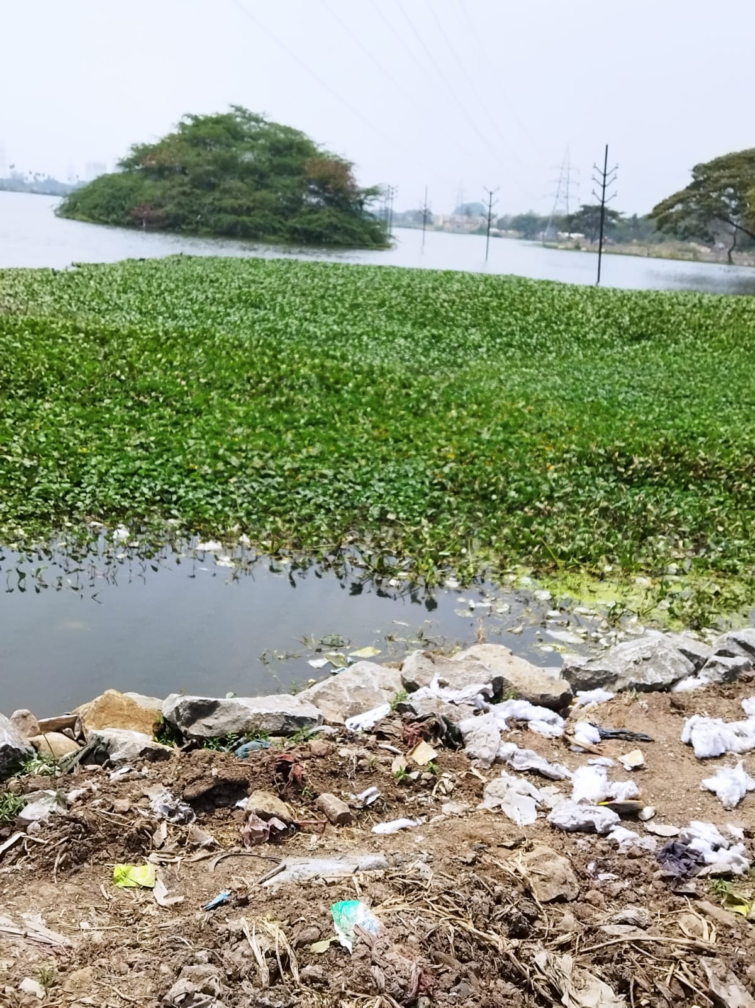
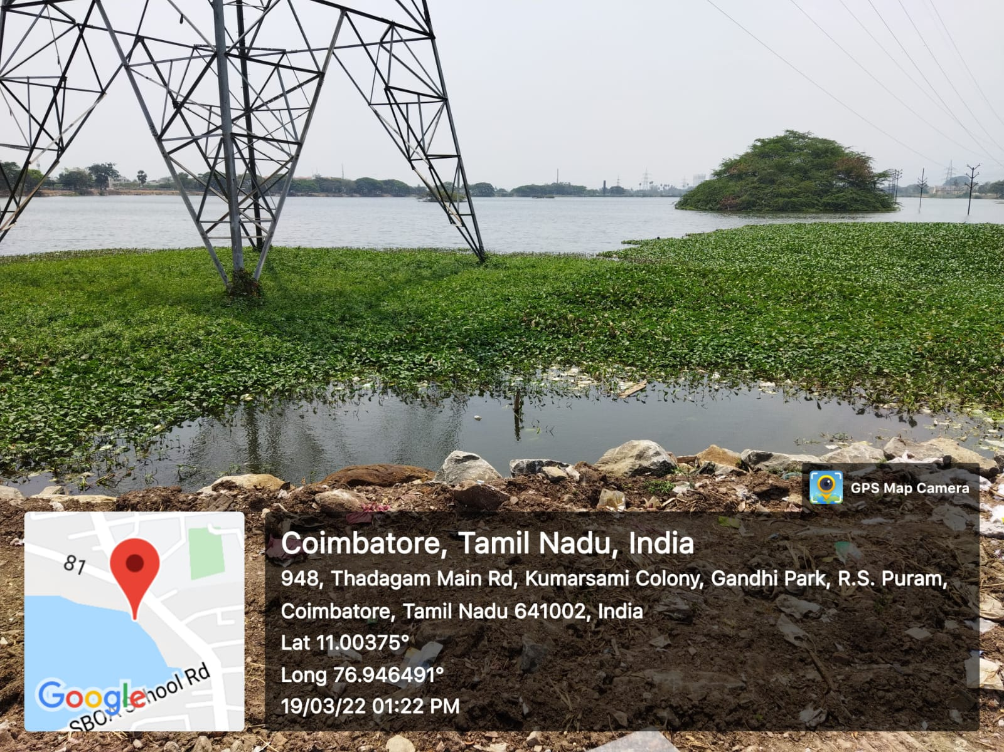

Slide 4
Objectives
The main objective is a prevent to the growth of water hyacinth by using sensors used to monitor water quality thereby ensuring well-being of aquatic eco-system.
Certain factor being monitored frequently in the water by using sensors to determine the pH, Salinity, Turbidity, Dissolved Oxygen and Temperature that contribute for hyacinth growth.
To give an entrepreneurial opportunities to both Governments and NGOs, by making use of certain best qualities of W.H

Slide 5
Existing Approaches
Biological Approaches:
Use of bio agents like exotic weevils to control.
Chemical Approaches:
Glyphosate Herbicide
Physical approaches :
Removing the hyacinth plants entirely from the water bodies.

Slide 6
Our Approach
https://miro.com/app/board/uXjVODBRmAo=/?track=true&utm_source=notification&utm_medium=email&utm_campaign=approve-request&utm_content=go-to-miro

Slide 7
Benefits of W.H
Much research has been devoted to its use as a feed material for many classes of livestock. In South-East Asia, integrated fish-pig-water hyacinth farming systems have been developed in order to increase global animal production.
Water hyacinths grown in fish ponds have higher nutritive value (higher protein content) and can be fed to fish and pigs in different forms
Water hyacinth is used as a water-clearing agent, as a substrate for mushroom production and as an ornamental species
Water hyacinth can be useful for the remediation of water contaminated with heavy metals, as the roots trap and remove from water large amounts of minerals, including heavy metals and radio-active elements (Hasan et al., 2009a). It has been effective in removing cadmium and zinc from moderately contaminated wate. However, there is still no commercial or large-scale application. Combining both water-clearing capacity and biogas production might be profitable: studies have shown that about 1 million L/d/ha of domestic sewage can be treated with water hyacinths, reducing the biochemical and chemical oxygen demand by 89 and 71% respectively

Slide 8
References
https://www.lakerestoration.com/t-water-hyacinth-control.aspx
https://www.thehindu.com/news/cities/Kochi/water-hyacinth-poses-threat-to-cage-fish-farming/article38139894.ece>
https://www.thehindu.com/news/cities/Kochi/water-hyacinth-poses-threat-to-cage-fish-farming/article38139894.ece>
https://www.feedipedia.org/node/160

Slide 9
Thank You

